Slide 1
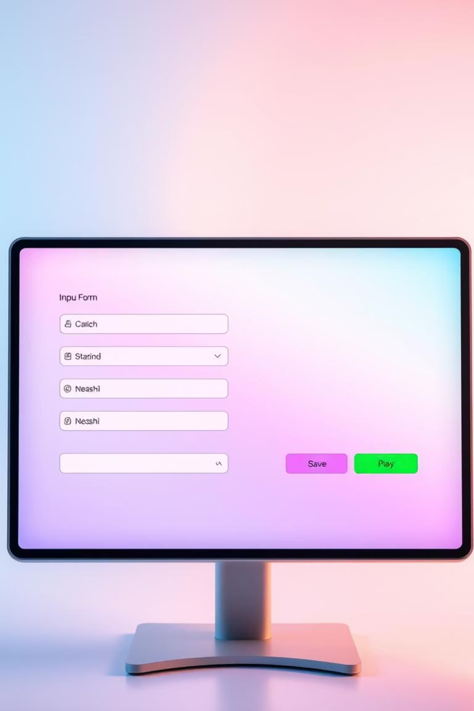
Mastering HTML Forms: A Comprehensive Guide
This presentation will walk you through the essential elements and attributes of HTML forms, empowering you to create robust and user-friendly web interfaces. We'll cover everything from basic form structure to advanced input types and usability enhancements.

Slide 2




Text-Based Input Types: Gathering User Data
Text & Password
Fundamental inputs for generic text (type="text") and obscured sensitive data (type="password").
Email & URL
Inputs that validate specific formats, crucial for contact (type="email") and web addresses (type="url").
Number & Tel
Dedicated for numerical entries (type="number") with min/max, and telephone numbers (type="tel").
These input types are foundational for capturing diverse textual and numerical information, each with specific validation and usability features.

Slide 3

Selection Input Types:
User Choices at a Glance
Radio Buttons: For mutually exclusive choices.
Users select only one option from a group.
Checkboxes: Allow users to select multiple options or none at all.
Dropdown Lists (): Compact lists for single or multiple
selections using option tags.
Datalist: Provides autocomplete suggestions for text inputs, blending free-form entry with predefined options.

Slide 4

Date & Time Inputs: Precision Scheduling
Date Picker
Simplifies date entry (type="date") using a calendar interface (YYYY-MM-DD), ensuring correct formatting.
Time & Datetime-Local
Dedicated inputs for time (type="time") and combined date-time (type="datetime-local") without timezone conversion.
Month & Week Pickers
Streamline selection of specific months (type="month") or weeks (type="week") within a year.
Leverage these specialized inputs to enhance user experience for scheduling, appointments, and chronological data collection.

Slide 5
Special Inputs & Buttons: Interactive Form Controls
File
Allows users to upload files with specific type restrictions (accept attribute).
Range
A slider control for selecting a numeric value within a specified range.
Color
Provides a color picker, enabling selection from a vast palette of 16.7 million colors.
Hidden
Invisible fields for submitting data not directly interacted with by the user.
Submit/Reset
Buttons for submitting form data or reverting fields to their initial states.
These advanced input types and buttons provide rich interactivity, enabling complex data capture and form actions.

Slide 6

Enhancing Forms: Validation & Usability for All
Textarea: Multi-line input for longer text entries.
Labels: Critical for accessibility, linking descriptive text to
form controls.
Fieldset & Legend: Visually group related form elements,
improving organization.
Validation: Attributes like required and pattern enforce data integrity, ensuring correct input.
Placeholders: Provide helpful hint text within input fields, especially useful on mobile devices.
ARIA Attributes: Essential for making forms accessible to users with disabilities, reaching a global audience.
By focusing on validation and usability, you can create robust, user-friendly, and accessible HTML forms that cater to diverse needs.

